Slide 1
CSC 430 Final Project:
Pharmacy Database System
Data🅱️ased
Cordus Bailey, Kennedy Ford, Casey Lee, Zachary Nalepa, and Will Shepherd

Slide 2
Entities
Relationships
Strong Entities:
Person
Product
Supplier
Order
Clinic
Weak Entities:
Employee
Customer
Pharm_tech
Cashier
Stocker
Jobs
Supplies
Buys
Has
Prescribes (ternary relationship)

Slide 3
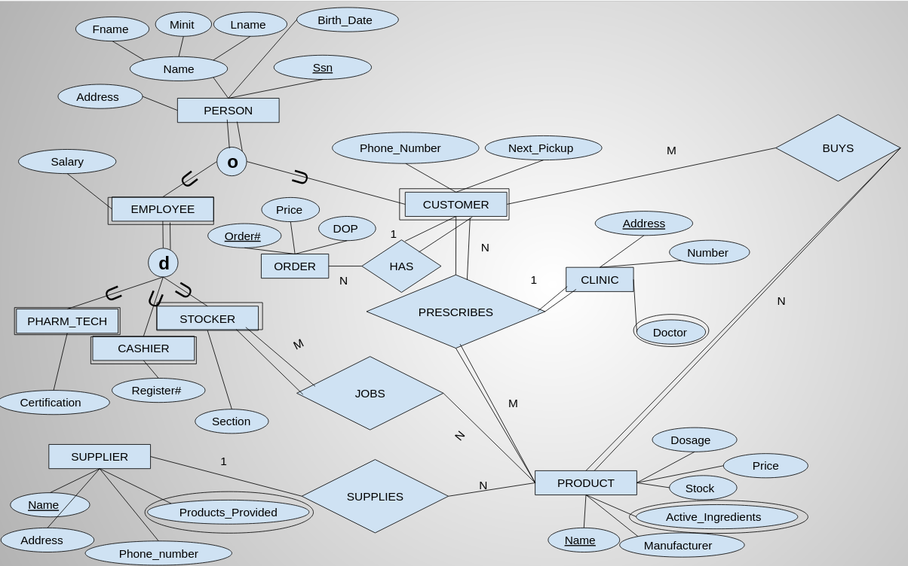

Slide 4
Triggers
New_product: Trigger to automatically make stock of a new product 0 if unspecified
Order_price: Trigger to automatically price an order if price is left null by adding the prices of all individual items of the order

Slide 5
Views
Customer_orders: Creates a view of all orders showing order number, products ordered, and customer name. Combines buys and order
Stock_location: Creates a view of products and the section they are stocked in
Low_stock: Creates a view of the product names and their stock, if the stock is less than 5

Slide 6
Demonstration

Slide 7

Conclusion

